Slide 1
Физика столкновений тяжелых ионов
Е. Крышень
Научная сессия ОФВЭ
25 декабря 2012

Slide 2
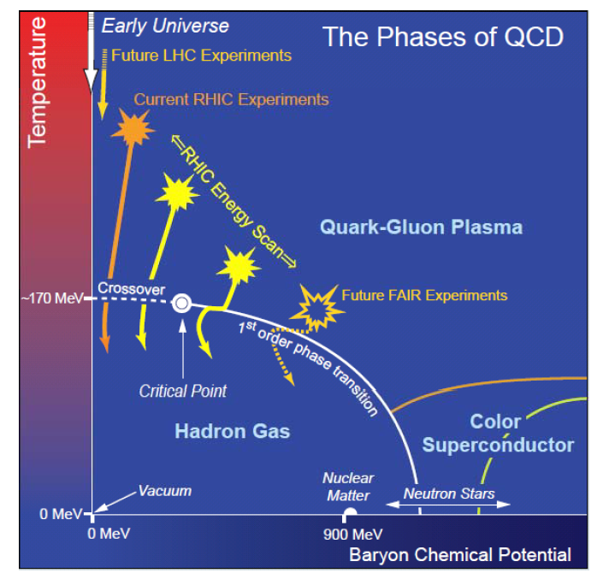
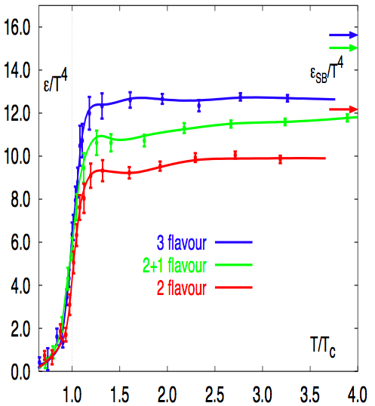
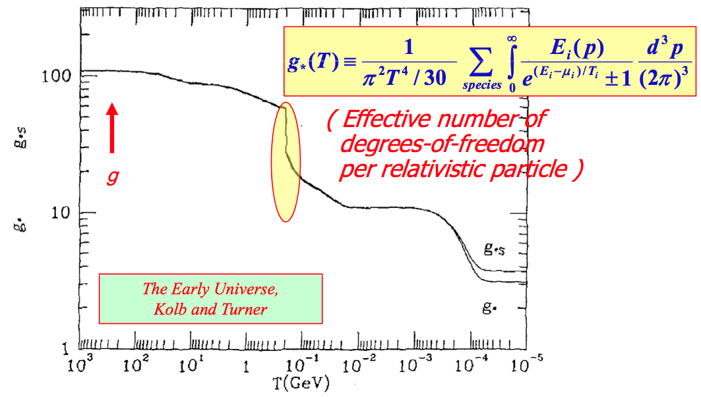
Phase diagram
Latice QCD: QCD matter undergoes a transition from a hadronic gas to a quark-gluon plasma at a temperature T_{c} ~170 MeV
At small net baryon density, the transition is a smooth cross-over spanning a temperature range of 20-30 MeV
much reduced condensate of light quarks → approximate restoration of chiral symmetry
screening of chromo-electric force between heavy quarks → absence of quark confinement

Slide 3
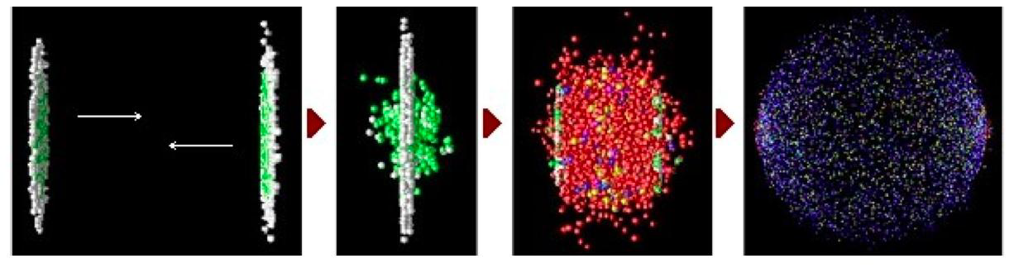
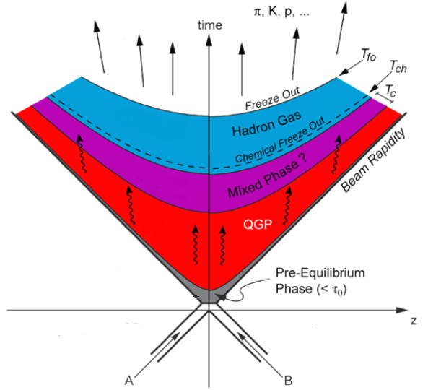
HIC: physics motivation
Goal: study nuclear matter at extreme conditions of temperature and density
Heavy ion collisions studied since AGS, SPS & RHIC
Produced QCD matter initially thought as weakly interacting gas of quarks and gluons but
found as strongly interacting matter:
  short mean free path
  high collectivity and flows
  large parton energy-loss
  almost perfect liquid (η/s ~ 1/4π)

Slide 4
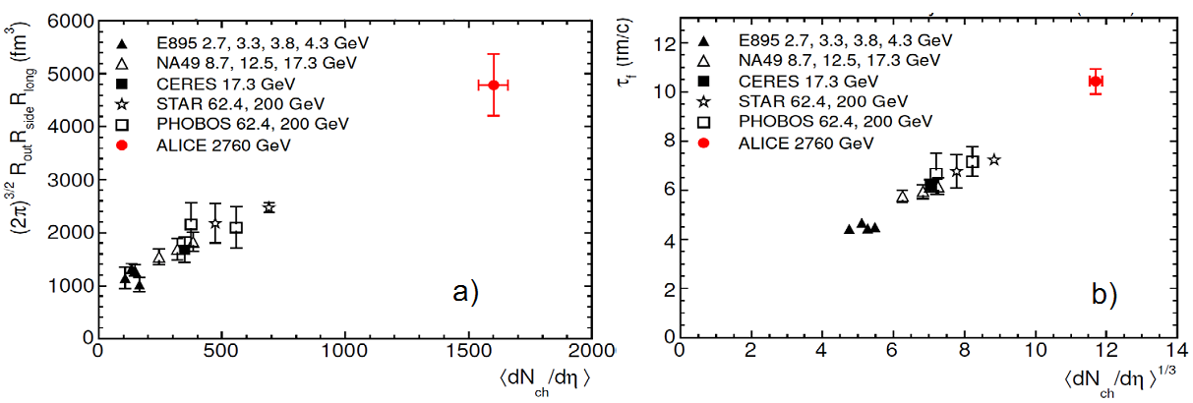
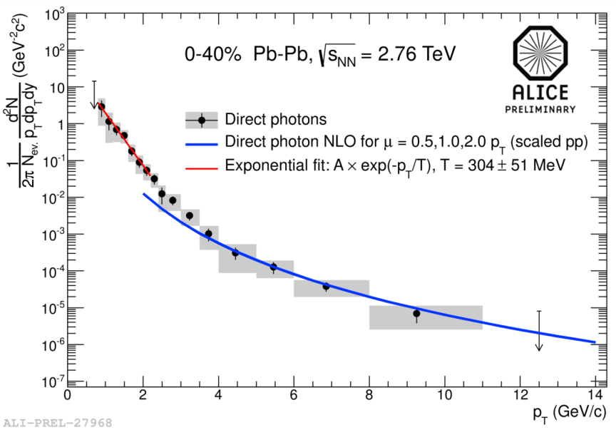
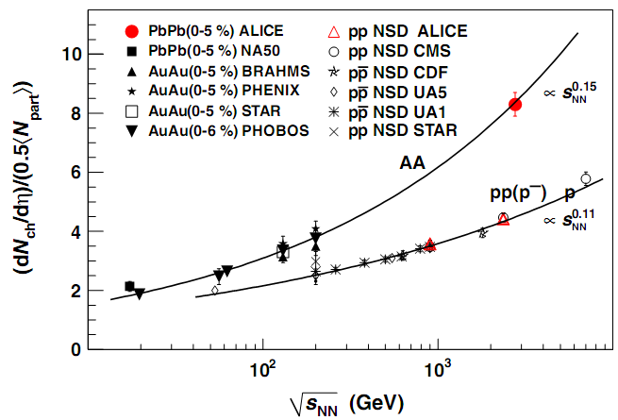
Global properties
Volume ≈ 2 x RHIC (≈ 300 fm³)
Lifetime (> 10 fm/c ~ 3x10⁻²³ с)
+40%
x 2
RHIC
RHIC
Photon T = 304±51 MeV ~ 1.4 x RHIC
Energy density ~ 3 x RHIC ~ 10 GeV/fm3
?

Slide 5
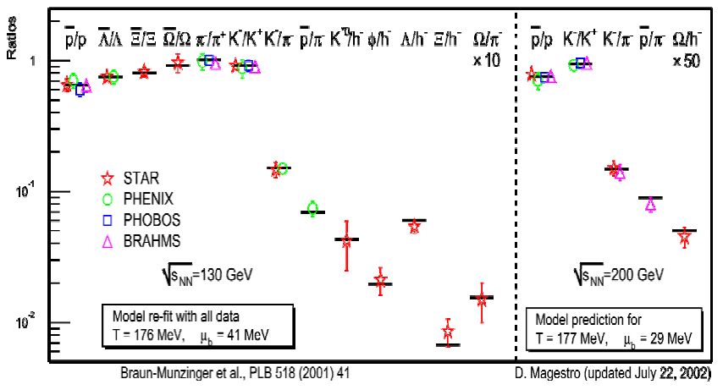
Hadrochemistry / thermal models
Hadron yields and ratios up to RHIC energies well-fitted by statistical model in terms of T,μ_{B}
Extracted (T,μ_{B}) in good agreement with transition curve in lattice QCD phase diagram
Confirmed/refined by RHIC data on beam energy scan.
At LHC, some tension with statistical description
- Hadronic re-interactions?
- Importance of charm contribution to strangeness production?

Slide 6

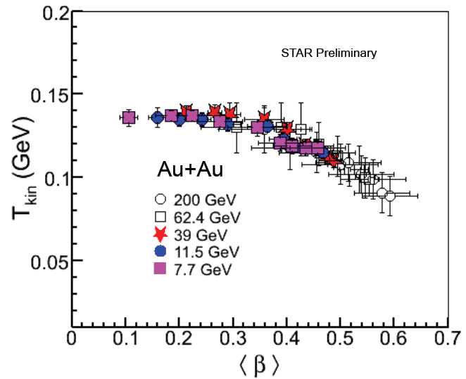
RHIC energy scan and statistical model
Observation of a centrality dependence of the freeze-out temperature vs. baryon chemical potential (beam energy)
Radial flow increase from most peripheral collisions at √sNN = 7.7 GeV to most central Au-Au events at √sNN = 200 GeV

Slide 7
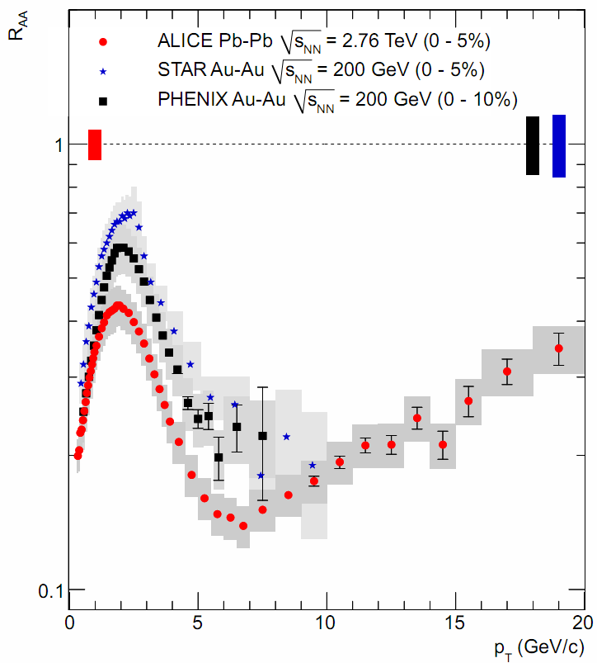
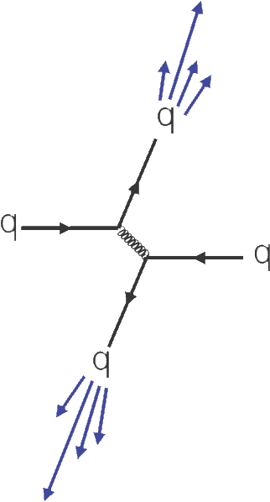
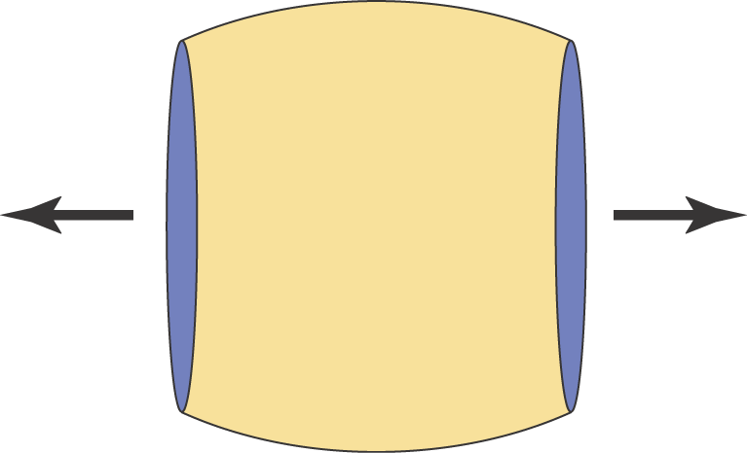
Strong suppression for hadrons
Stronger suppression at LHC

Slide 8
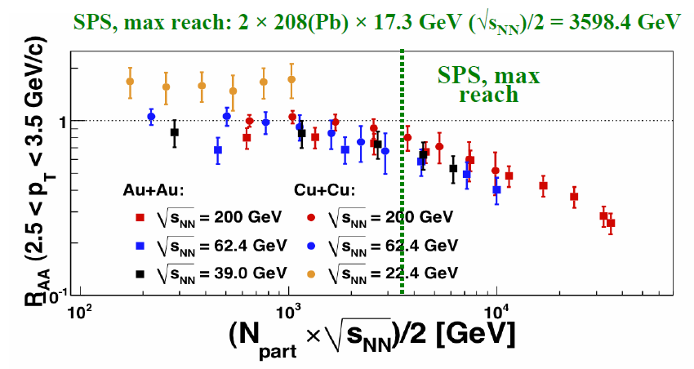
RHIC energy scan
полная накопленная энергия

Slide 9
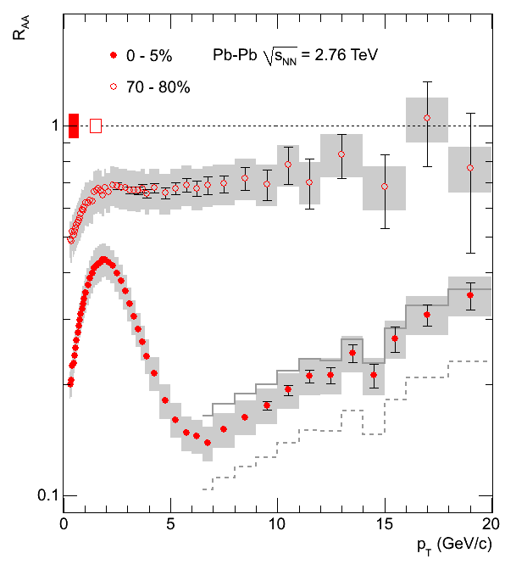
3 regions in p_{T}
Low: p_{T} < 3-4 GeV/c
Bulk properties and collective radial flow
Intermediate: 3 < p_{T} < 7 GeV/c
Test of valence quark scaling
Anomalous baryon enhancement and coalescence
High: p_{T} > 7 GeV/c
Jet fragmentation, modification of fragmentation functions in medium
ALICE, Phys. Lett. B696, 30 (2011)

Slide 10
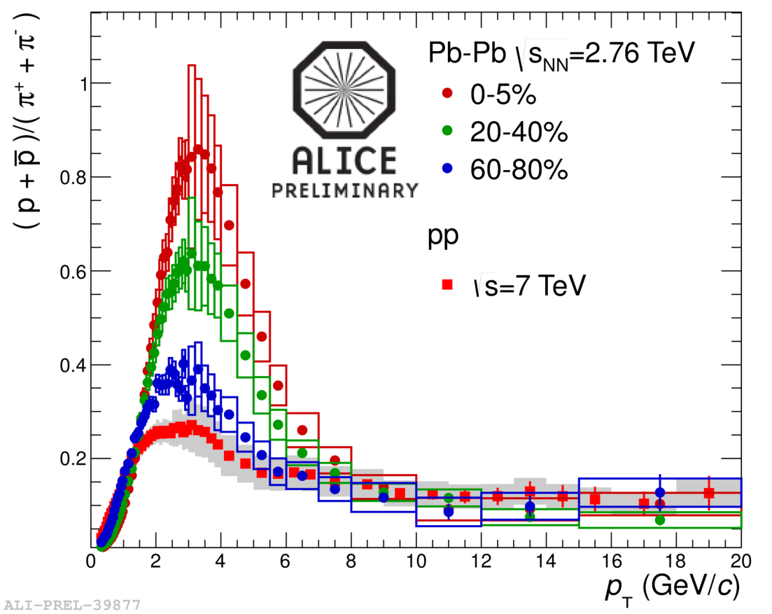
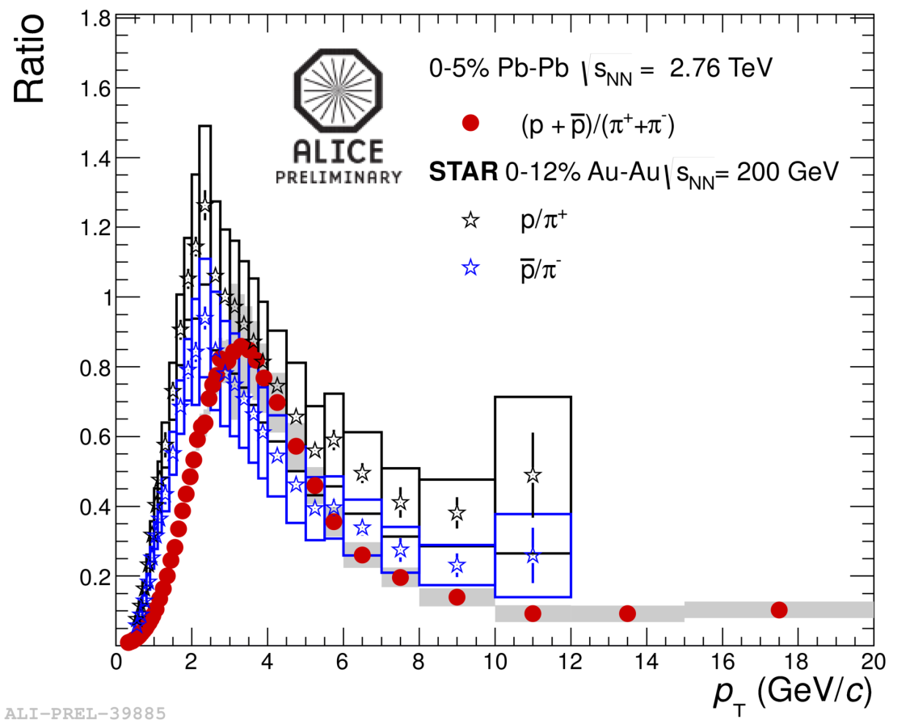
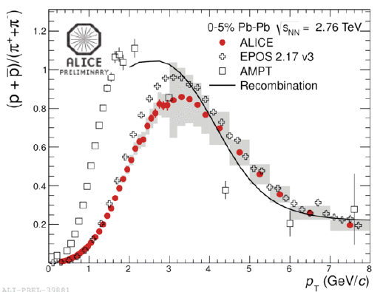
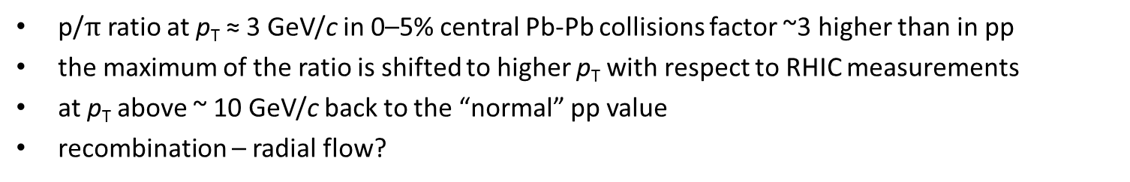
Baryon-to-meson ratio: p/π
p/$π$ ratio at p_{T} ≈ 3 GeV/c in 0–5% central Pb-Pb collisions factor ~3 higher than in pp
the maximum of the ratio is shifted to higher p_{T} with respect to RHIC measurements
at p_{T} above ~ 10 GeV/c back to the “normal” pp value
recombination – radial flow?

Slide 11
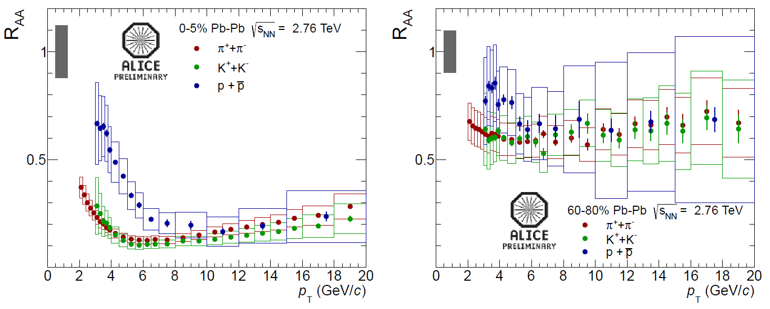
Identified particles R_{AA}
  Strong suppression confirming previous measurements for non-identified particles
For p_{T} below ~ 7 GeV/c:
  R_{AA}(π) < R_{AA}(h±)
  R_{AA}(K) ≈ R_{AA}(h±)
  R_{AA}(p) > R_{AA}(h±)
At higher p_{T}: R_{AA} are compatible → medium does not significantly affect the fragmentation.

Slide 12
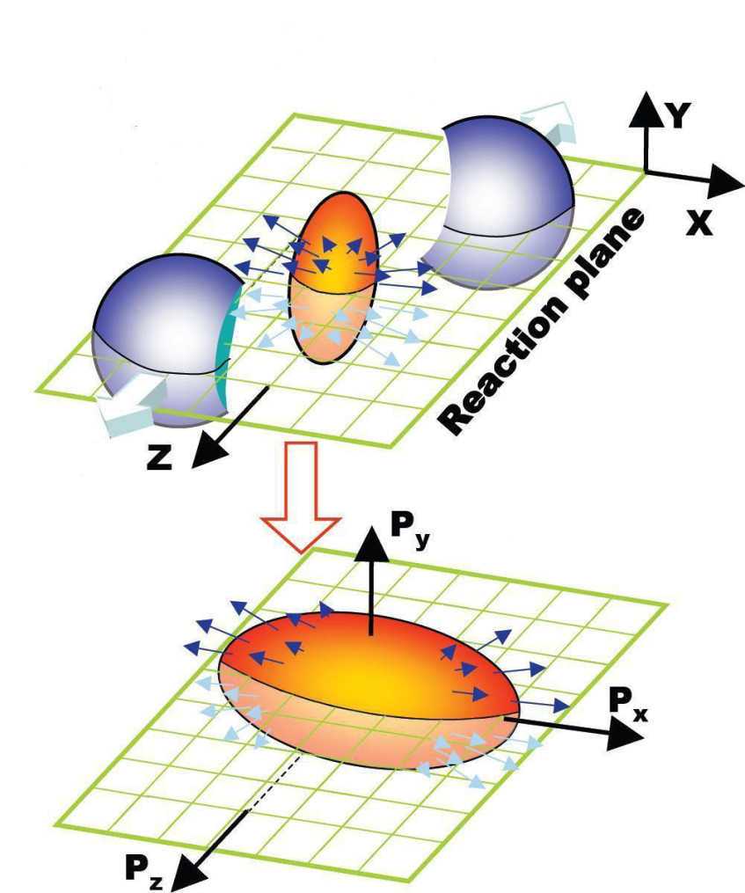
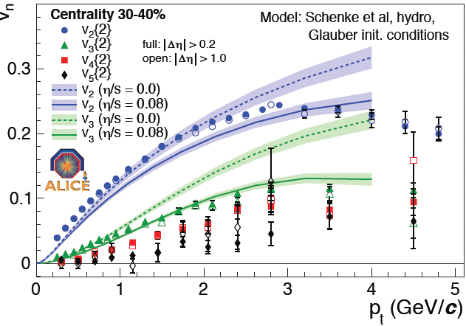
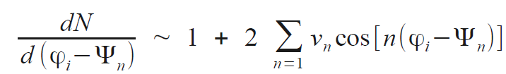
Anisotropic flow
Spatial asymmetry transforms into momentum space:
Phys. Rev. Lett. 107, 032301 (2011)

Slide 13
Hydrodynamics and flow
3+1 dim hydro dynamics reproduces v₂, v₃, v₄, v₅ in p_{T} and centrality for matter with same dissipative property
Most conservative bound:
0.07 < η/s < 0.43
Models increasingly sensitive to initial conditions and their (quantum) fluctuations
Schenke
IP-Sat. Glasma
MC-KLN
MC-Glauber

Slide 14
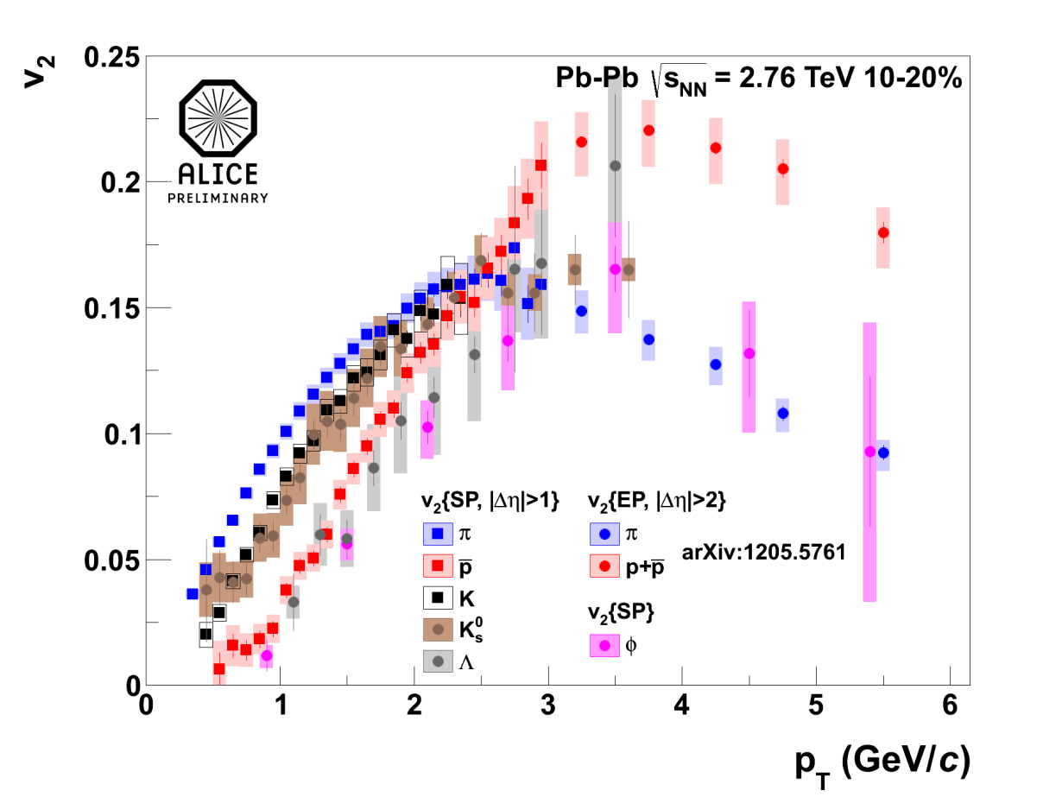
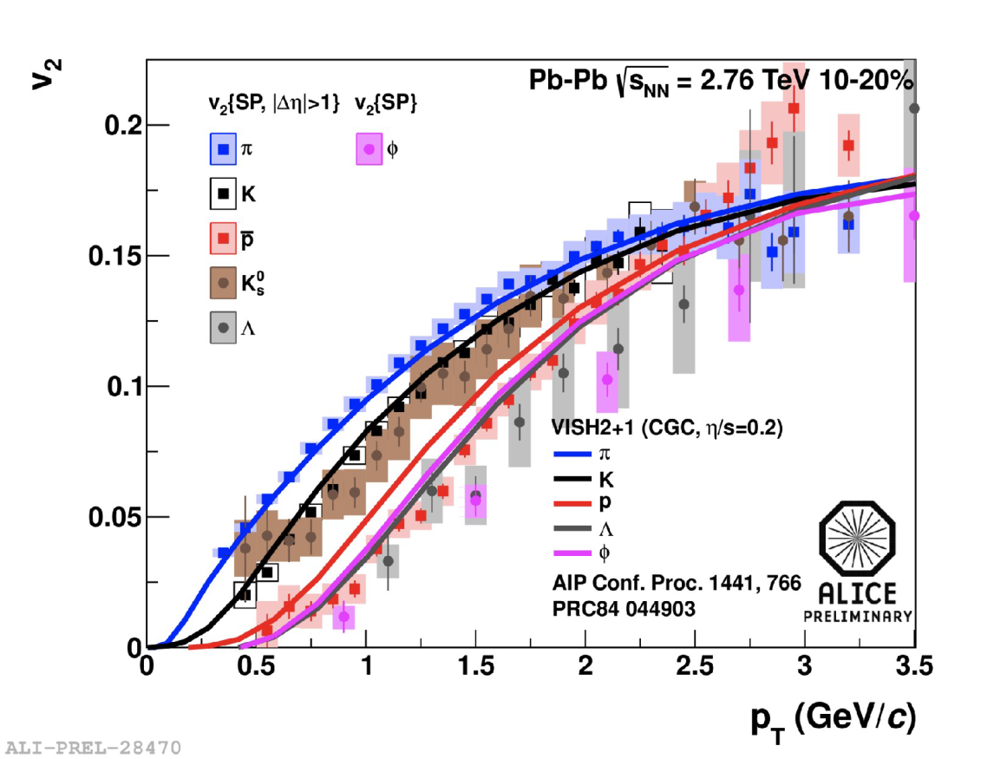
Identified particle v₂
Mass ordering observed at low p_{T} for π, p, K±, K⁰_{s}, Λ, φ and (not shown) Ξ, Ω
𝜙-meson follows mass dependence at p_{T} < 3 GeV/c and “meson band” at higher p_{T}
Overall qualitative agreement with viscous hydro calculations at low p_{T}
Hadronic rescattering phase improves agreement

Slide 15
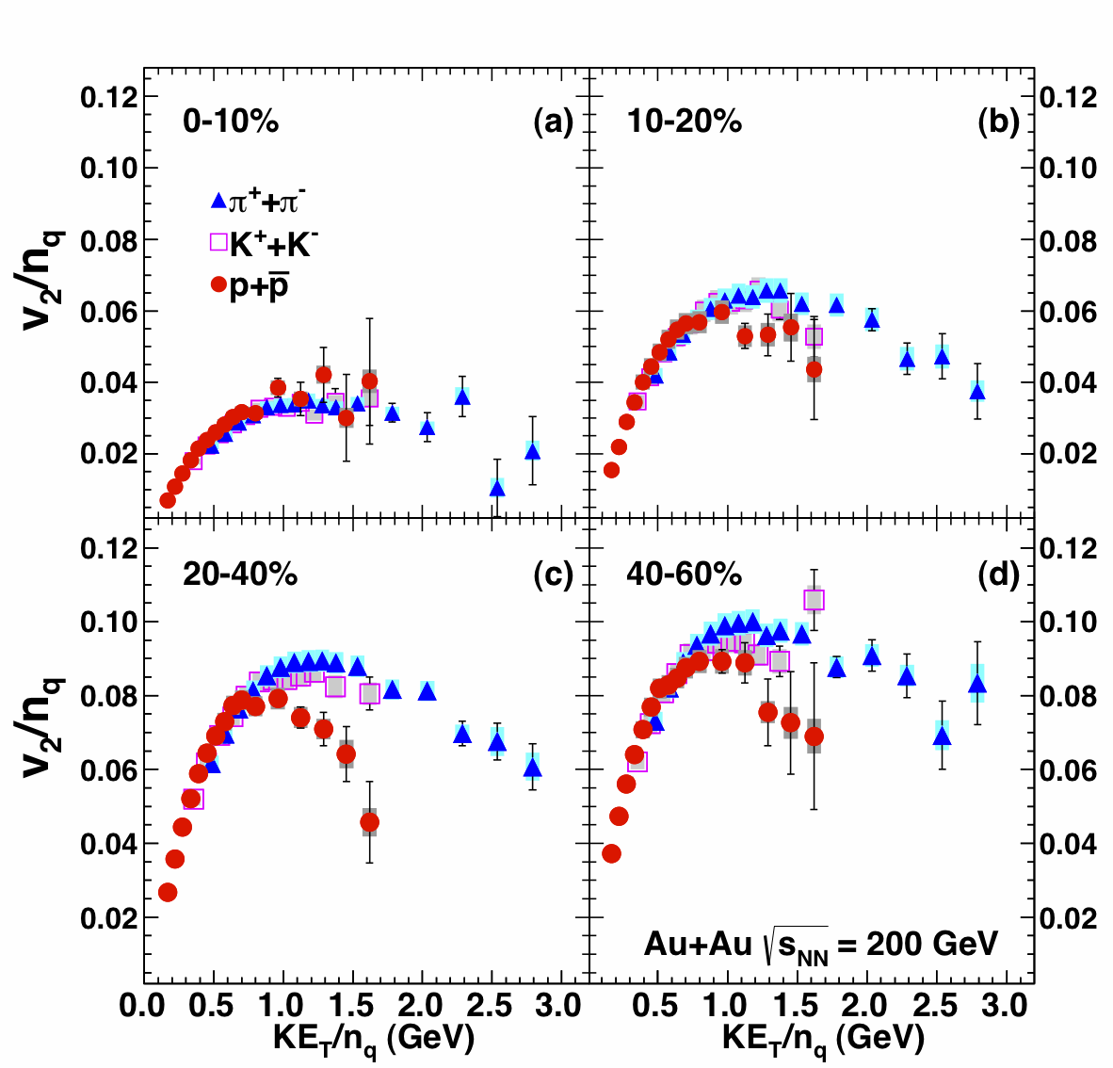
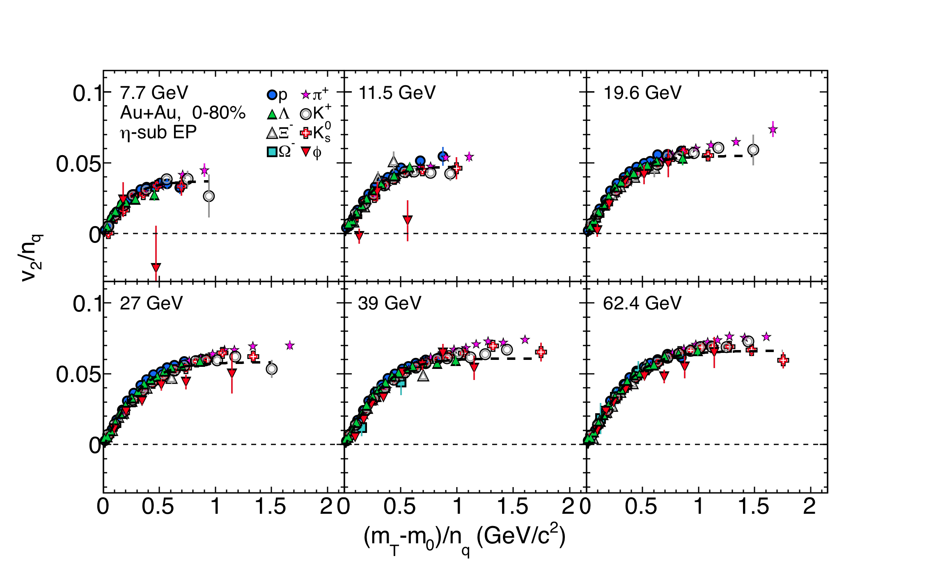
NCQ scaling: RHIC
STAR, S.Shu at QM2012
PHENIX Phys. Rev. C85 064914(2012)
NCQ scaling holds quite well at
any centralities at low energies...
NCQ scaling at RHIC holds in 0-10%
centrality bin: deviations start at ~1GeV/c
Particles

Slide 16
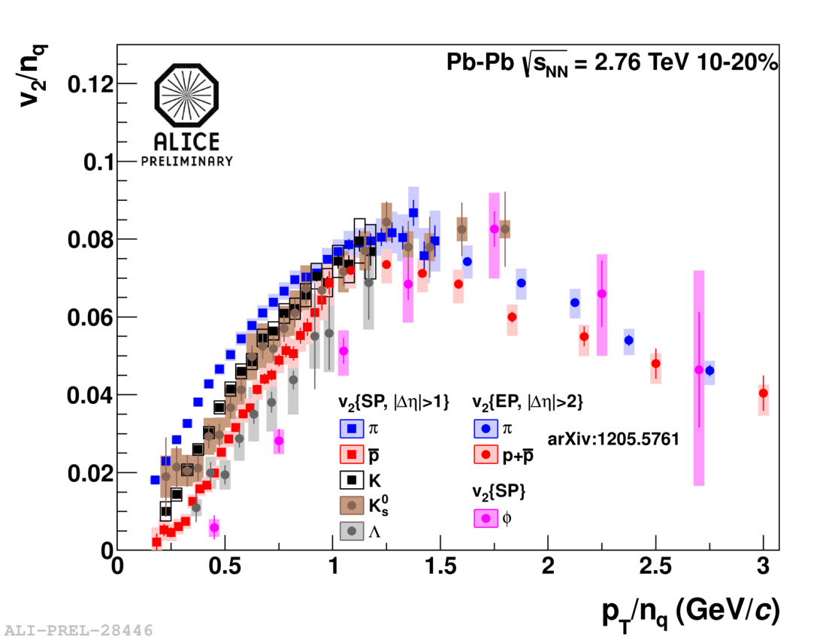
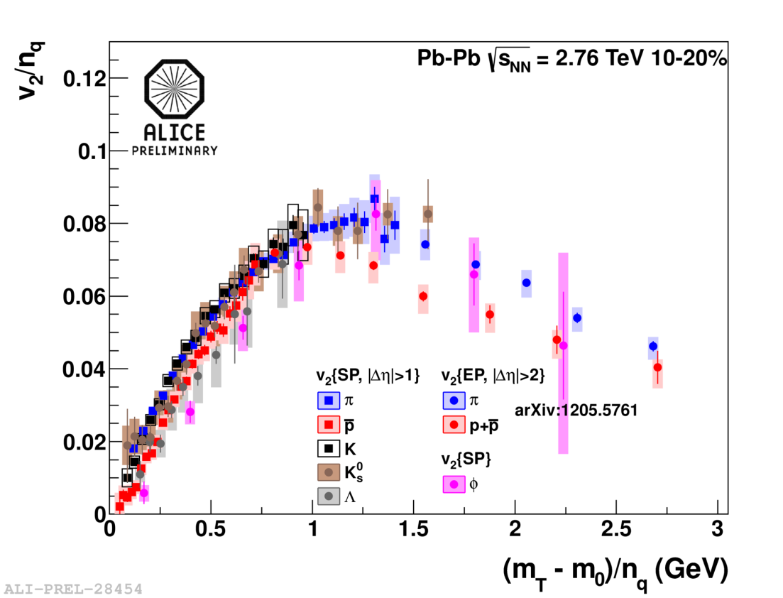
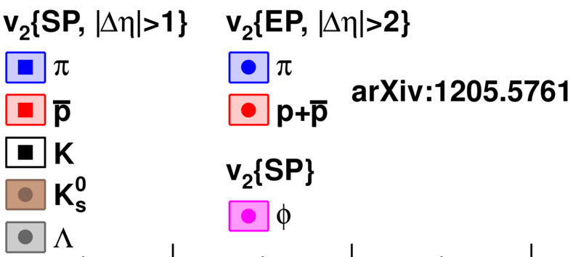
NCQ scaling breaking: LHC
scaling off by 10‐20% at high p_{T} (where mass is negligible)
stronger radial flow or jet quenching/ rescattering, more important than coalescence ?

Slide 17
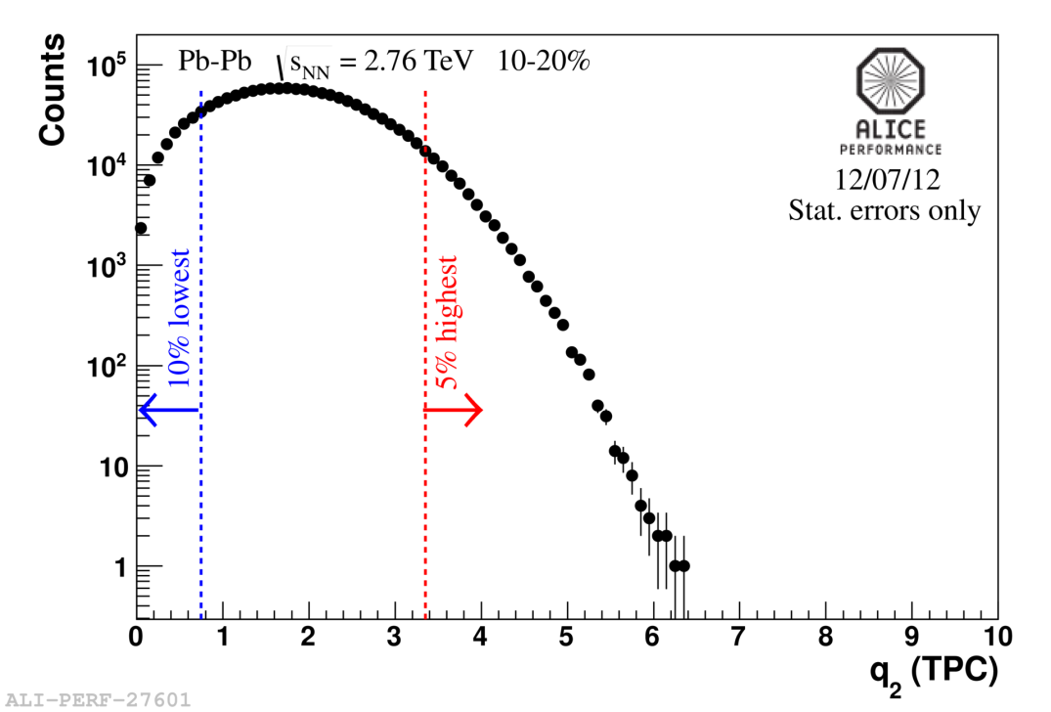
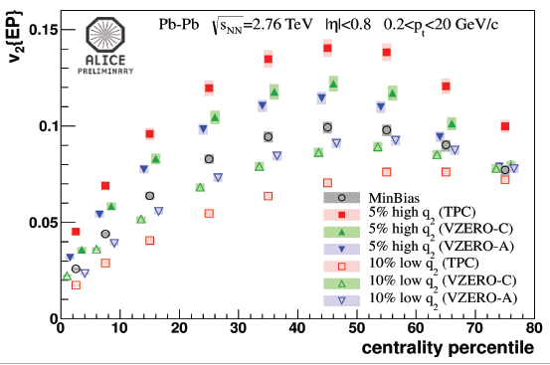
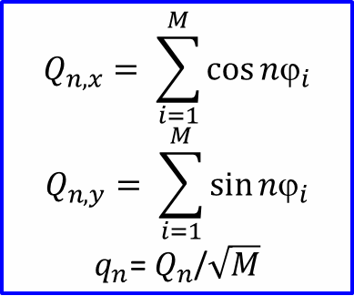
Event Shape Engineering
New tool towards better understanding of elliptic flow
$$Q_{n,x}= \sum_{i=1}^{M}{\cos{nϕ_{i}}}$$
$$Q_{n,y}= \sum_{i=1}^{M}{\sin{nϕ_{i}}}$$
$q_{n}$= $Q_{n}$/$\sqrt{M}$
At fixed centrality large flow fluctuations
v₂ splits by factor of two for semi-central events (30–50%)

Slide 18
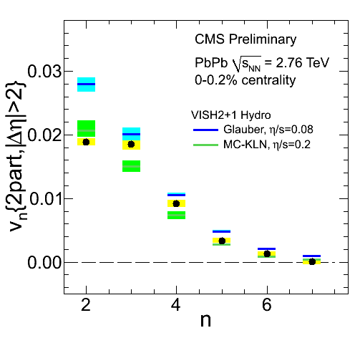
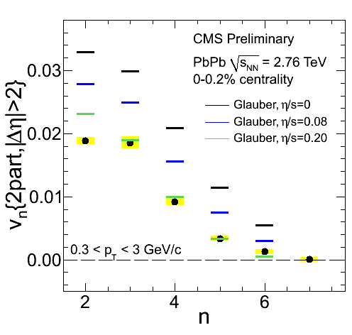
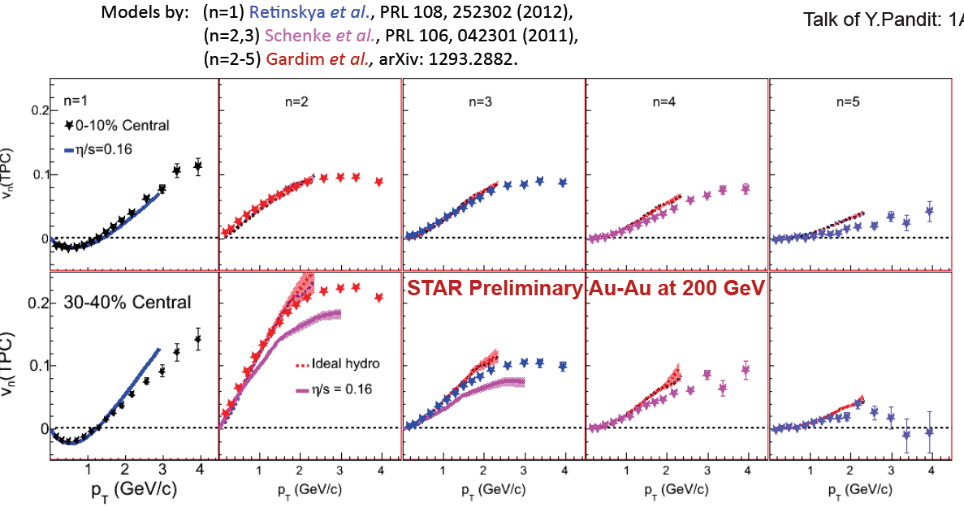
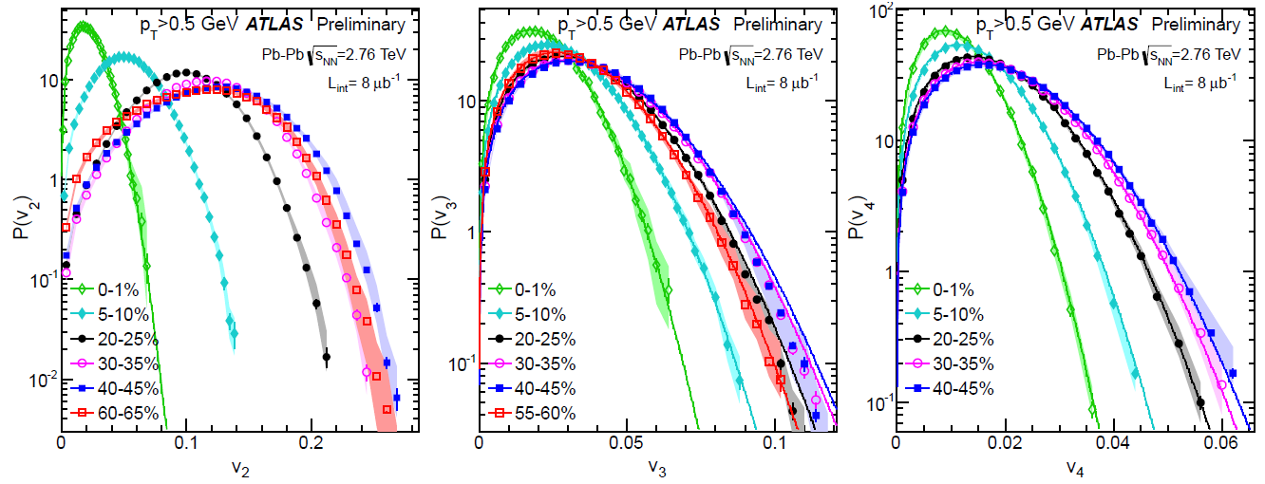
More flow…

Slide 19
Hard probes

Slide 20
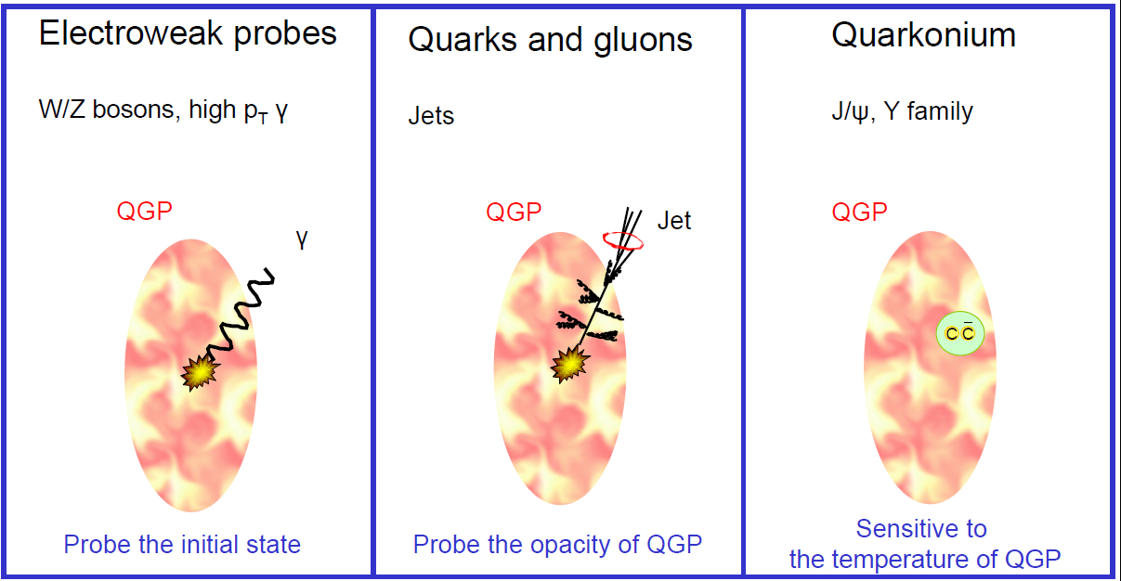
Three types of hard probes

Slide 21
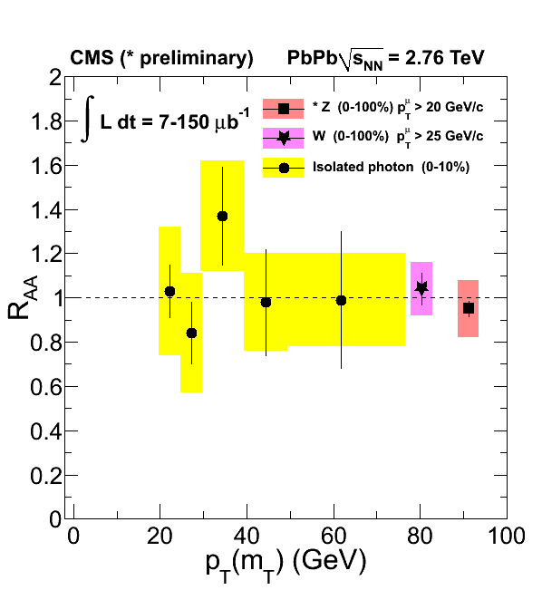
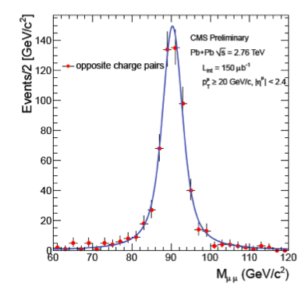
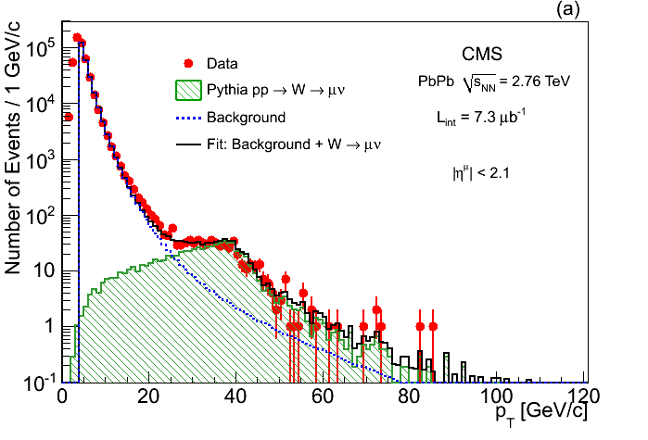
Electroweak probes
PLB 710 (2012) 256
CMS-PAS HIN-12-008
Z⁰ →μ⁺μ⁻
W→ μν using
single muon recoil
against missing p_{T}
N_{coll} scaling confirmed
arXiv:1205.6334
Accepted by PLB

Slide 22
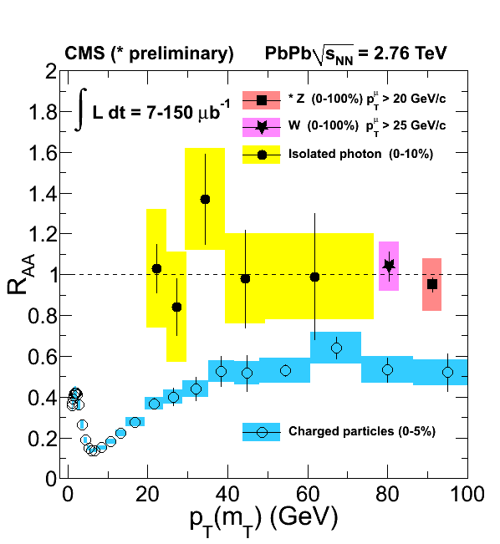
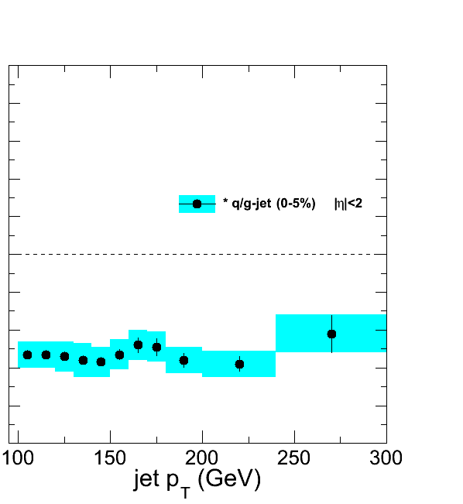
Suppression of charged particles
Fully unfolded inclusive jet R_{AA}
pp 2.76 TeV reference
Charged hadron R_{AA} flat for
p_{T} = 30 - 100GeV
Like for charged particles, high-p_{T} jet R_{AA} flat at ≈ 0.5

Slide 23
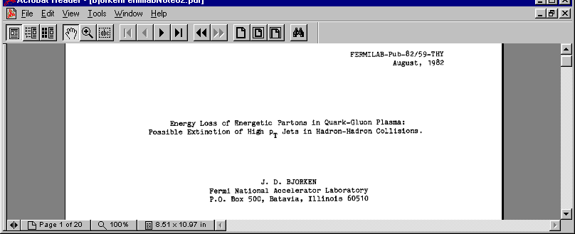
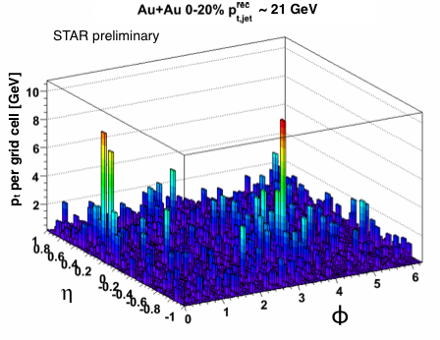
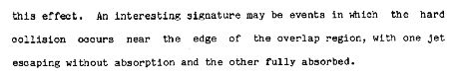
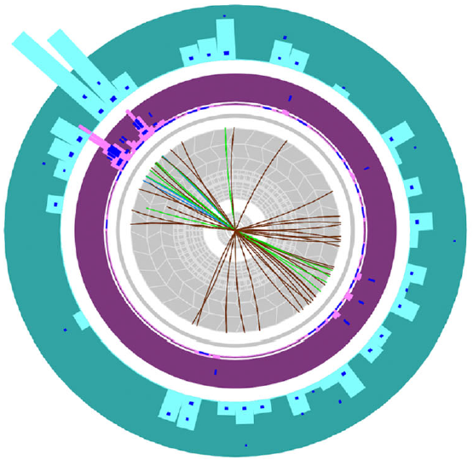
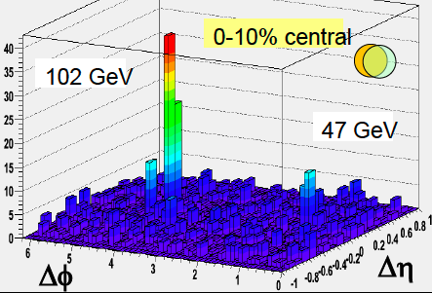
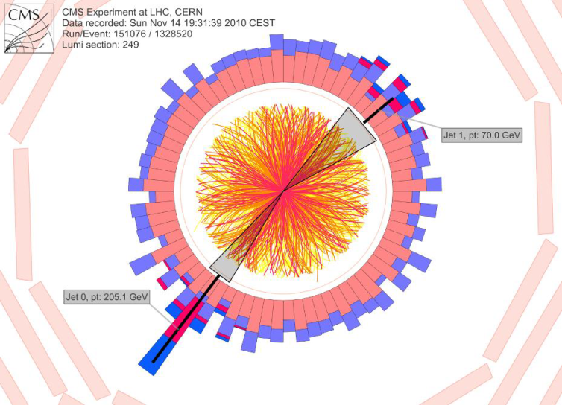
Jet quenching
STAR
STAR preliminary
ALICE
ATLAS
CMS

Slide 24
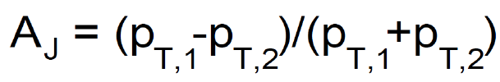




Dijet asymmetry
pp reference
Small A_{J}
(Balanced jet)
Large A_{J}
(Un-alanced jet)
Parton energy loss is observed as a pronounced energy imbalance in central PbPb collisions
No apparent modification in the dijet Δφ distribution
(Dijet pairs are still back-to-back in azimuthal angle)
However information on initial jet momentum is missing + surface bias

Slide 25


γ+jet – “golden channel”
Photon
(191GeV)
Jet
(98 GeV)
Photon tag:
Identifies jet as u,d quark jet
Provides initial quark direction
Provides initial quark p_{T}

Slide 26




γ+jet: u,d quark energy loss
nucl-ex/1205.0206
Jet-photon p_{T} balance
drops by 14%
20% of photons lose
jet partner

Slide 27



D meson R_{AA}
JHEP 1209 (2012) 112
D⁰, D⁺ and D*⁺ R_{AA} compatible
within uncertainties.
Suppression up to a factor 5
at p_{T}~ 10 GeV/c.

Slide 28

D meson R_{AA:} comparison to charged pions
Average D-meson R_{AA}:
– p_{T} < 8 GeV/c hint of slightly less
  suppression than for light hadrons
– p_{T} > 8 GeV/c both (all) very similar:
  no indication of colour charge dependence

Slide 29


D meson v₂
Non-zero D-meson elliptic flow observed:
consistent among D-meson species (D⁰, D⁺, D^{*+})
comparable to v₂ of light hadrons
Simultaneous description of R_{AA} and v₂ – challenge for transport models

Slide 30
Quarkonia

Slide 31



Screening and initial temperature
Different states have different binding energies
Loosely bound states melt first!
Successive suppression of individual states provides a “thermometer” of the QGP

Slide 32


Suppression or enhancement?
LHC energies : Enhancement via (re)generation of quarkonia, due to the large heavy-quark multiplicity (A. Andronic et al., PLB 571, 36 (2003))

Slide 33

SPS summary plot
NA50 (Pb-Pb) and NA60 (In-In) results:
In-In 158 GeV (NA60)
Pb-Pb 158 GeV (NA50)
Anomalous suppression for central Pb-Pb collisions
Agreement between Pb-Pb and In-In in the common N_{part} region
Pb-Pb data not precise enough to clarify the details of the pattern!
After correction for EKS98 shadowing
B. Alessandro et al. (NA50), EPJC39 (2005) 335
R. Arnaldi et al. (NA60), Nucl. Phys. A (2009) 345
Anomalous suppression up to ~30%, compatible with ψ(2S) and χ_{c} melting, i.e. with a sequential suppression scenario!

Slide 34

RHIC results
Comparison of R_{AA} results obtained at different rapidities
Mid-rapidity
Forward-rapidity
Stronger suppression at forward rapidities
Not expected if suppression
increases with energy density
(which should be larger at
central rapidity)
Are we seeing a hint of
(re)generation, since there are
more pairs at y=0?
Or may other effects (e.g. cold
nuclear matter effects) explain
this feature ?

Slide 35

RHIC vs SPS
Nice “universal” behavior
Maximum suppression ~40-50%, still compatible with only ψ(2S) and χ_{c} melting
N.Brambilla et al., EPJ C71(2011) 1534

Slide 36


J/ψ suppression at LHC: R_{AA} vs ⟨N_{part}⟩
Comparison with PHENIX: stronger centrality dependence at lower energy
Systematically larger R_{AA} values for central events in ALICE
Behaviour qualitatively expected in a (re)generation scenario
→ Look at theoretical models

Slide 37


R_{AA} vs ⟨N_{part}⟩ in p_{T} bins
recombination
recombination
Compare R_{AA} vs ⟨N_{part} ⟩ for low-p_{T} (0<p_{T}<2 GeV/c) and high-p_{T} (5<p_{T}<8 GeV/c) J/ψ
Different suppression pattern for low- and high-p_{T} J/ψ
Smaller RAA for high p_{T} J/ψ
In the models, ~50% of low-p_{T} J/ψ are produced via (re)combination, while at high p_{T} the contribution is negligible → fair agreement from N_{part}~100 onwards
Need pA for cold nuclear matter effects

Slide 38


J/ψ v₂
The contribution of J/ψ from recombination should lead to a significant elliptic flow signal at LHC energy
STAR: v₂ compatible with zero everywhere
ALICE: hint for non-zero v₂
Significance up to 3.5 σ
Qualitative agreement with transport models including regeneration

Slide 39


Sequential suppression
2011 data
arXiv:1208.2826
Observation of sequential suppression of Y family
Expected in terms
of binding energy
CMS-PAS HIN-12-014, HIN-12-007

Slide 40
pA highlights

Slide 41


dN_{ch}/dη in p-Pb collisions
arXiv:1210.3615 [nucl-ex]
pA crucial to discriminate between initial (cold nuclear matter) effects and QGP dynamics
p-Pb at LHC → probe nuclear wave-function at low x → nuclear gluon shadowing
CGC: steeper η_{lab} dependence than the data
HIJING (with shadowing) and DPMJET: describe the η-shape rather well
mid-rapidity 〈Npart〉 normalized 〈dN_{ch}/dη〉 p-Pb similar trend to pp

Slide 42


Charged particle R_{pA}
consistent with unity for p_{T} > 2 GeV/c
the strong suppression observed in Pb-Pb is
NOT an initial-state but
hot QCD matter effect
arXiv:1210.4520 [nucl-ex]

Slide 43
Conclusions
Early to make conclusions…
Wealth of physics results from RHIC and first two LHC heavy-ion runs:
  bulk, soft probes: spectra and flow of identified particles, thermal photons
  high-p_{T} probes: jet fragmentation, particle-type dependent correlations
  heavy-flavour physics: suppression and flow of D mesons, quarkonia
Entering the precision measurement era:
  First studies of cold nuclear matter effects with p–Pb collisions, more next year

Slide 44

A (valid) analogy

Slide 45
Backup

Slide 46
ALICE physics perspectives
 |  | Status as of today | Reachable for approved | Reach with the upgrade
Bulk production | light flavours, v₂, HBT | quantitative | precision | precision
Intermediate p_{t} | v₂, correlations, baryon-meson | quantitative | precision | precision
High-p_{t} – jets | R_{AA}, correlations, jet fragm. | quantitative | precision | precision
 | heavy-flavour in jets |  | hint | quantitative
 | PID fragmentation | hint | quantitative | precision
Heavy flavour | D-mesons, R_{AA} | quantitative |  | precision
 | D-meson v₂ | hint |  | precision
 | beauty, D_{s} | hint | quantitative | precision
 | charm baryons |  | hint | Quantitative
Charmonia | J/ψ forward, R_{AA} | quantitative | precision | Precision
 | J/ψ v₂ | hint | quantitative | precision
 | ψ’, χ_{c} |  |  | quantitative
 | J/ψ central, Υ family | hint | quantitative | precision
Dileptons – γ | virtual γ | hint |  | quantitative
 | ρ-meson |  |  | quantitative
Heavy nuclei | hyper(anti)nuclei, H-dibaryon | hint | quantitative | precision

Slide 47

Example: Heavy-flavour v₂
High rate, new ITS
No high rate, new ITS
need >> 1 nb⁻¹ for precise measurement of charm and beauty v₂
systematic uncertainties and corrections mostly cancel in v₂
Other key measurements: Λ_{b}, Ξ_{c}, B decays, virtual γ, ψ’, χ_{c}, tagged jets…

