Slide 1

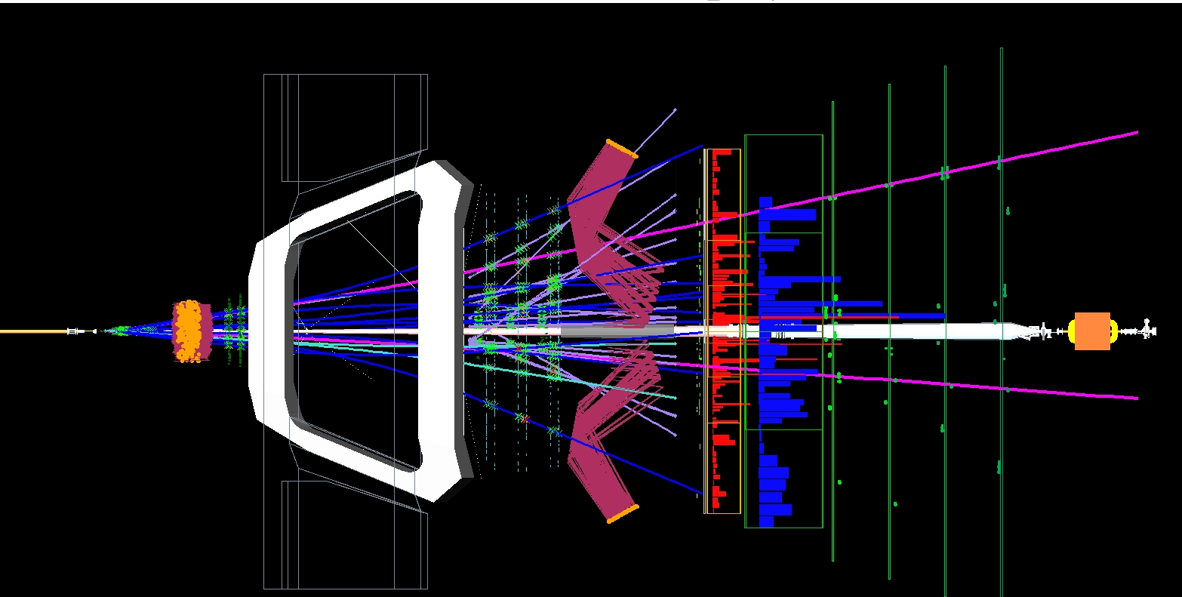


Статус поиска распада B_{s}→2µ в LHCb.
Новогодняя научная сессия ОФВЭ
27 Декабря 2011
µ
µ
Mμμ = 5.357 GeV, BDT = 0.90, B meson decay length = 11.5 mm
Ю. Щеглов, А.Дзюба, А.Воробьёв, Н.Сагидова ПИЯФ

Slide 2
OUTLOOK
Introduction. Recent B_{s,d} → 2 µ results
Physics motivation
LHCB detector. Fast facts
Main backgrounds
Strategy of the analysis. List of BDT input parameters
B_{s} → 2 µ analysis jungle. Normalization channels. BDT response and invariant mass resolution calibrations
Background estimates
Extraction of the limit. Results and future plans
Progress in B_{s} → µ ⁺ µ⁻ search during last 10 years
Conclusions

Slide 3
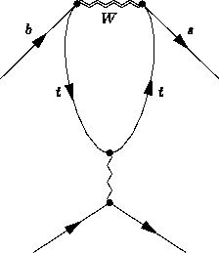
Introduction. B mesons penguin diagram decays
SM forbids flavor-changing neutral currents (FCNC) diagrams
FCNC can be introduced by penguin one loop diagrams
If some B-meson decays can be realized only via penquin diagram decay, these decays can be sensitive to the new physics
Decay examples: Bs→2µ, Bd→K*μ+μ-, Bd→K*γ, Bs→φγ, etc.
..and many of them now can be studied at LHCB detector

Slide 4
Introduction. B_{s} → 2 µ decay. Existing upper limits
Observed upper limits at the Tevatron and LHC before summer 2011:
CDF observed limit at L = 3.7 fb⁻¹ : Br (B_{s} → 2µ ) < 4.3 x10⁻⁸ (95% CL)
Br (B_{d} → 2µ ) < 7.6 x10⁻⁸ (95% CL), [CDF public note 9892 ]
D0 observed limit at L = 6.1 fb⁻¹ : Br (B_{s} → 2µ ) < 5.1 x10⁻⁸ (95% CL), Phys. Lett. B 693, 539 (2010), [arXiv:1006.3469]
LHCB published observed limit at L = 37 pb⁻¹ : Br (B_{s} → 2µ ) < 5.6 x10⁻⁸ ,
Br (B_{d} → 2µ ) < 1.5 x10⁻⁸ at 95% CL, Phys. Lett. B699 330 (2011), [hep-ex/1103.2465]
LHCB provided approximately the same result as CDF with 100 times less integrated luminosity! (more higher cross –section, better geometric and muon pT acceptance)
…but last summer news from CDF arXiv: 1107.2304 [hep-ex] : 0.46 x 10⁻⁸ < BR < 3.9x10⁻⁸ @ 90% CL , (BR=1.8+ 1.1 -0.9) x 10⁻⁸
Not confirmed. Huge signal fluctuation ??

Slide 5
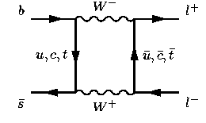
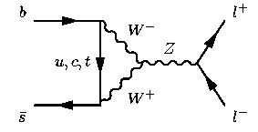
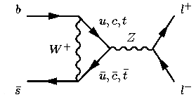
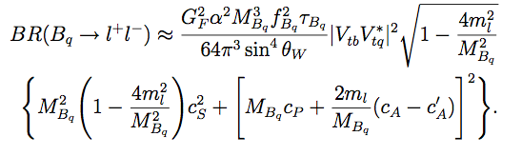
Physics motivation: B_{s} → 2 µ Standard Model diagrams
B_{s} → 2 µ is double suppressed decay: FCNC process and helicity suppressed
As a result SM diagrams give branching ratios: Br(B_{s} → 2 µ) =(3.2±0.2) x10⁻⁹, Br(B_{d}→ 2 µ) = (1.1±0.1) x10⁻¹⁰ , (A.J.Buras: arXiv:1012.1447, E. Gamiz et al: Phys.Rev.D 80 (2009) 014503)

Slide 6
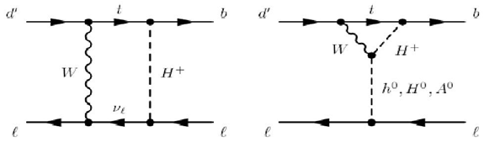
Physics motivation: MSSM models
B_{s} → 2 µ branching ratio can be very sensitive to the SUSY diagrams contributions. Two Higgs-Dublet (2HDM) model provides a big contribution in the region of the large tan β
NUHM1 model. The indirect B_{s} → 2 µ search power (blue regions) can be comparable with the results of direct SUSY searches (gray region):

Slide 7
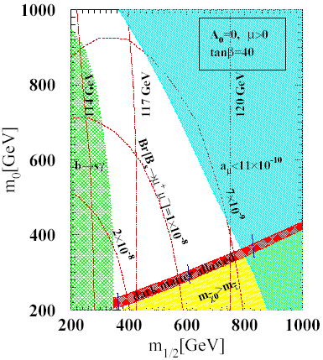
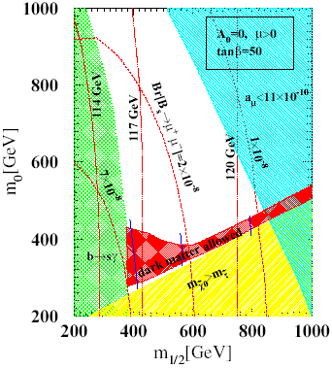
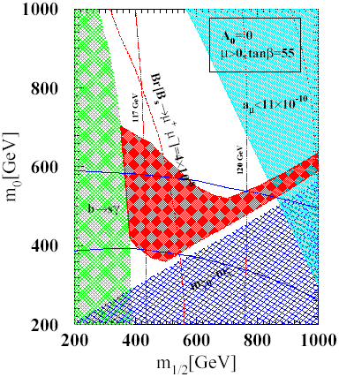
Physics motivation: mSUGRA model
Evaluation of the Br(B_{s} → 2 µ ) behavior for the different mSUGRA model parameters
G-2 collab. David Hertzog: “We are central to the US Intensity Frontier..”
G-2 restrictions
G-2 restrictions
G-2 restrictions
If we believe to the G-2 experiment restriction (light blue color) we have very exiting time on LHCB now, because LHCB has a plan to reach the sensitivity Br(B_{s} → 2 µ ) ~ 7-8 x 10⁻⁹ (90% CL) with the 2011 year experimental data

Slide 8
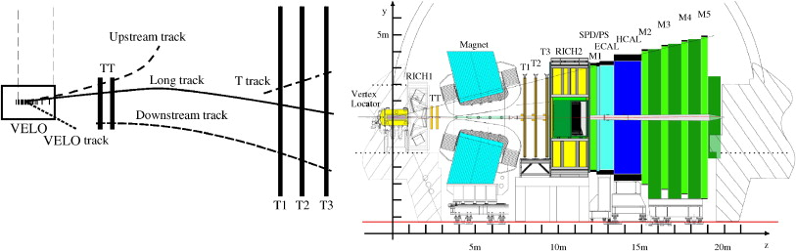
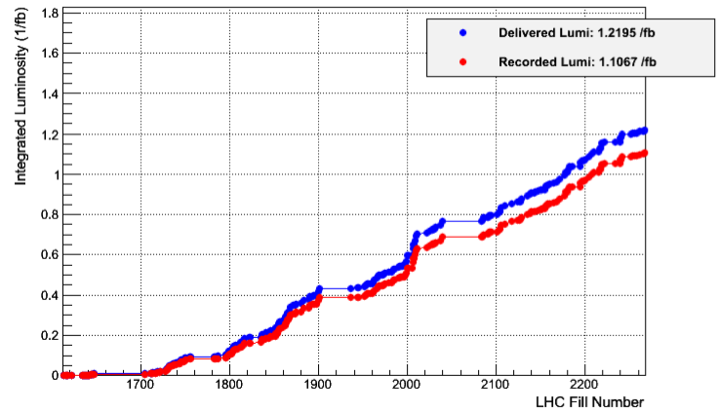
LHCb detector
Detectors are critical for the analysis:
M1, M2, M3, M4, M5 – muon stations
VELO (Vertex Locator) – vertex detector
TT, T1,T2,T3 – tracking stations
RICH1, RICH2 – Cherenkov detectors
Data taking efficiency close to 91 %
including data quality!

Slide 9
Fast facts
Luminosity and interactions
  σ _{inelastic}(pp, √s=7 TeV ) = 60 mb, σ(bb) = 245.6 ±28.9 µb
  Number of bunches - 1296
  L_{max} = 4 x 10³² ,<L> ~ 2.65 x 10³² cm⁻²s⁻¹
  Average number of interactions v = 1.6
  The total recorded luminosity (today), ∫ Ldt = 1100 pb⁻¹
  10¹¹ b decays in our acceptance
  ∫ Ldt = 370 pb⁻¹ used for the last B_{S} →μμ analysis
Parameters are relevant to the B_{S} →μμ analysis
muon identification efficiency : ε(μμ) ~ 98%
misidentification rate ε(h→μ)< 1% for p>10 GeV/c
invariant mass resolution : σ (M Bs,d→µµ) = 26 MeV/c²
impact parameter resolution: σ(IP) =25 μm at pT=2 GeV/c

Slide 10
Main backgrounds
bb→μμX events
can be suppressed using different geometric and kinematic criteria
photoproduction dimuon background
  Isolated muons with a possible contribution to the B_{s} mass region (removed at pT(B)> 500 MeV/c)
misidentified muons from B_{d/s} → h⁺h⁻ decays (
contribution from B_{d/s} →h⁺h⁻ can be calculated from B_{d/s} → h⁺h⁻ MC with a known misidentification probablity measured in data
Resulting misID expectations for the 300 pb⁻¹:
0.5±0.4 misID events in B_{s} mass region
2.5±0.5 misID events in B_{d} mass region
  After reconstruction the SM prediction for 300 pb⁻¹ is 3.4 (0.32) B_{S} (B_{d}) →μμ events

Slide 11
Strategy. Key points of the analysis
Selection conditions
  Muon trigger used
  Preliminary selections to reduce datasets size
  Blind signal region 5306 < M_{Bs} <5426 MeV
Signal and background training
Use B_{s}→2µ and bb→µµX Monte–Carlo events to train the Boosted Decision Tree method
Signal calibration
Use the control channel B→hh
Normalization
Use B⁺→J/ΨK⁺ , B_{S}→J/Ψφ, B⁰→⁻K⁺ to calculate the total number of Bs mesons
Upper limit calculation
Use the signal and normalization channel efficiency to calculate the normalization factor
Use the predicted background and number of observed events with the modified frequentist CLs method to estimate the upper limit and confidence level
BDT response

Slide 12
List of input parameters for Boosted Decision Tree method
A decision tree is able to split the phase space into a large number of hypercubes , where each can be identified as “signal-like” or “background-like”
The phase space in the analysis is defined by 9 input parameters:
Transverse momentum of the B_{s} - meson
Minimum muon pT
Cosine of the B_{s} polarization angle, cos P
B_{s} meson impact parameter, IP_Bs
Minimum distance between muon tracks, DOCA
Muon track impact parameter significance, IPS_µ
B_{s} time life , t(B_{s} )
Muon isolation
B_{s} isolation

Slide 13
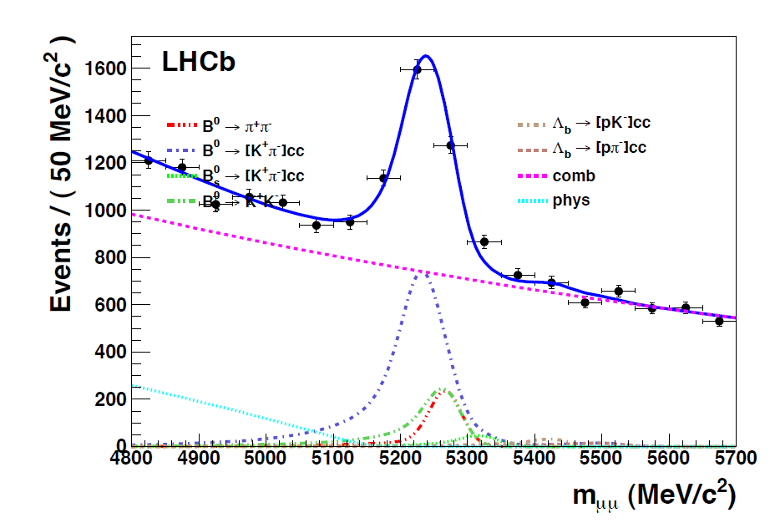
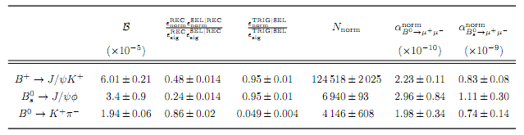
Normalization channels
To calculate the B_{s}→μ⁺μ⁻ branching ratio we need to know the total number of Bs mesons and next to use this number for the normalization
We have used 3 normalization channels :
B⁺→J/ψK⁺
B_{S}→J/ψφ
B⁰→π⁻K⁺
Normalization channel branching
Fragmentation ratio
*combined LHCB measurements
Calculated from MC
Measured from data
Number of events in normalization channel
Final numbers
for 370 pb⁻¹

Slide 14
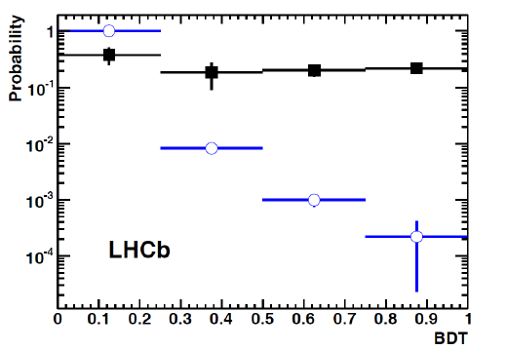
BDT response calibration
For the calibration of signal BDT response we have used the data from B mesons hadronic decays - B_{d/s} → h⁺h⁻ (B_{d/s} →KK,K, )
The main advantage is same topology as B_{s}→μ⁺μ⁻ . The problem is a difference between muon and hadronic trigger. As a result for the signal calibration only events triggered independently from the - B_{d/s} → h⁺h⁻ signal were used
The calibration results:
the probability density function for the signal is almost flat (dark squares on the plot)
the probability density function (blue circles on the plot) for the combinatorial background is obtained from the dimuons in the B_{s}→μ⁺μ⁻ mass sidebands
LHCb preliminary
300 pb⁻¹
LHCb preliminary
300 pb⁻¹

Slide 15
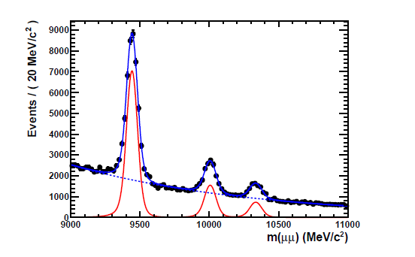
Invariant mass calibration
Invariant mass shape modeled by a Crystal Ball function (Gaussian core portion + low end tail)
To calculate the resolution we interpolate dimuon resonances (J/ψ, ψ(2s), Upsilons) masses
σ(J/Ψ) = 16 MeV/c²
LHCb
300 pb⁻¹
σ(Y) = 40 MeV/c²
LHCb
300 pb⁻¹
As a result we have :
σ(B_{s}) = (24.6±0.2±1.0) MeV/c²
σ(B_{d}) = (24.3±0.2±1.0) MeV/c²
  The calculated resolutions were checked up with the invariant mass shape of B_{s} → K⁺K⁻ and B⁰ → K⁺π⁻ decays

Slide 16
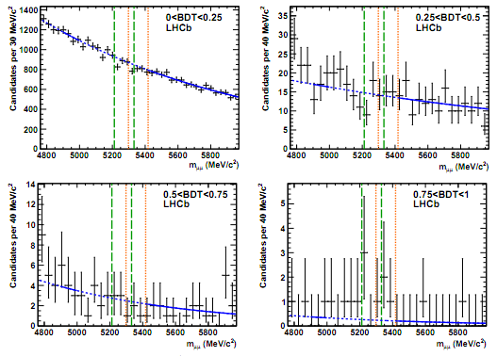
Background estimates
The combinatorial background estimate was derived from a fit of the mass sidebands for BDT bins with the blind signal region
The systematics of the backround prediction was studied using the exponential, double exponential and linear fitting functions

Slide 17
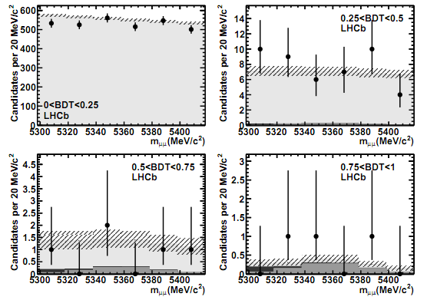
B_{s} Signal mass region for BDT response bins
As we can see we have good enough agreement between expected background , Standard Model predictions and number of events observed in the signal region
black dots are data; the light grey shows the contribution of the combinatorial background; the dark grey the contribution of SM B_{s}→2µ events

Slide 18
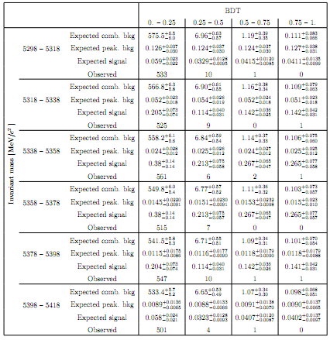
Expected combinatorial background events, expected peaking and signal events (SM branching) search window.

Slide 19
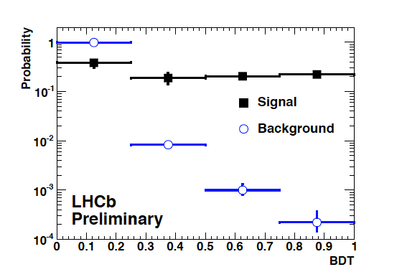
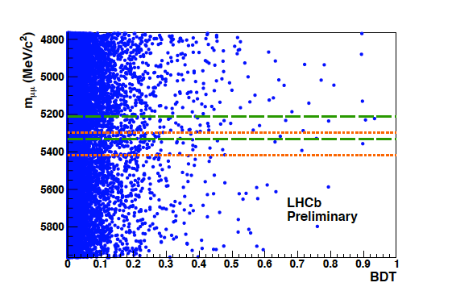
Extraction of the limit
BDT distribution for signal and background
µµ mass – BDT response plane
mass window
M_{Bs,d}± 60 MeV
The CLs analysis was performed in 2D space (dimuon mass – BDT response)
For the each observed event we calculated a probability to be compatible with the Signal + Background hypothesis or only Background hypothesis as a function of the branching ratio. Next we exclude the assumed branching ratio value at a given confidence level

Slide 20
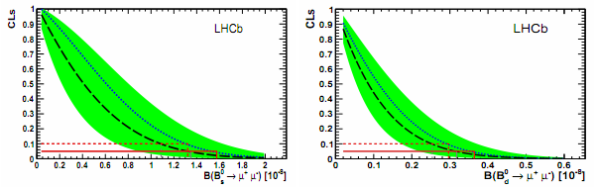
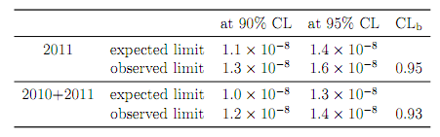
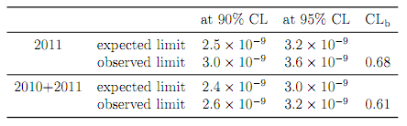
LHCB upper limit with the 370 pb⁻¹ 2011 data
Results of CLs analysis for B_{s}→2µ and B_{d}→2µ decays
Br(B_{s}→2µ) upper limit with 370 pb⁻¹
Br(B_{d}→2µ) upper limit with 370 pb⁻¹
Combination with 2010 data (37pb⁻¹), Br < 1.4 x 10⁻⁸ at 95 % CL
Improvement with the factor ~4 by comparison with the 2010 data result!

Slide 21
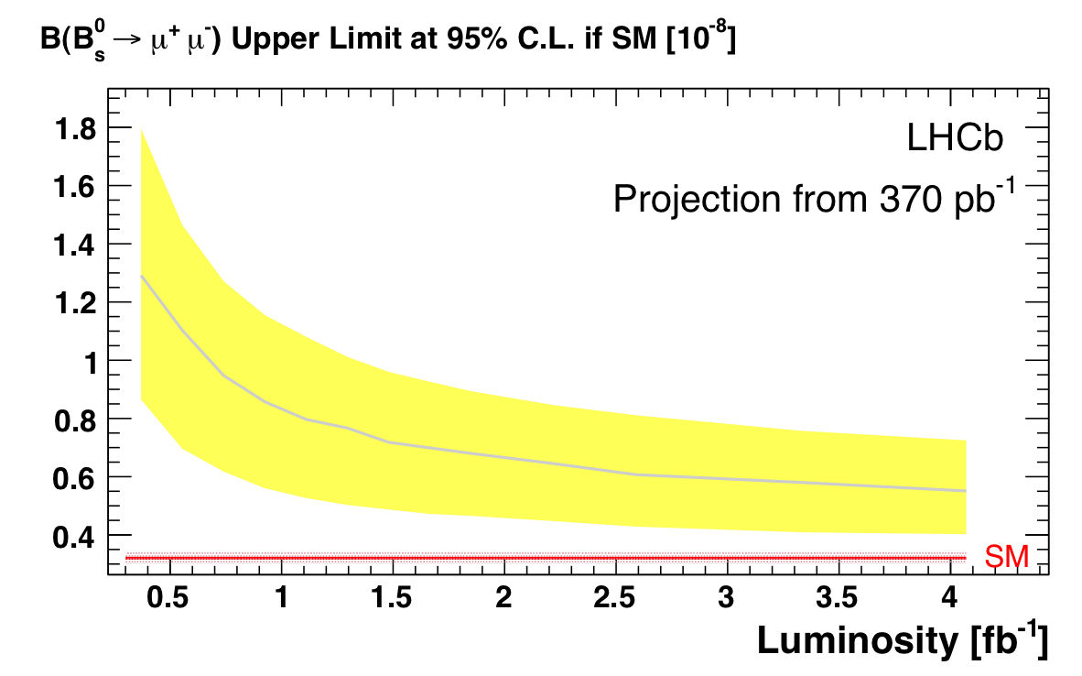
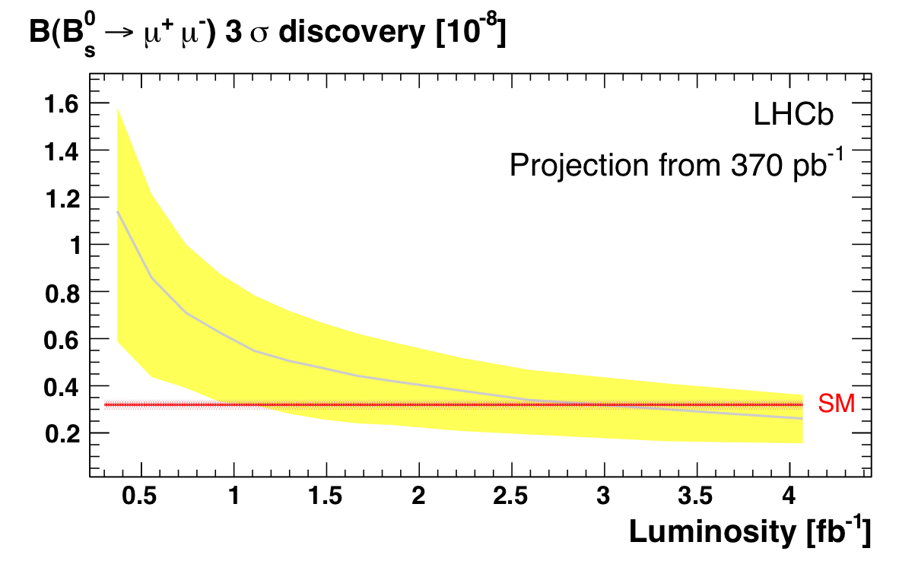
Future plans. 2012 year
Exclusion curves for the B_{s} → µ ⁺ µ ⁻ branching
3 sigma evidence curves
We have a chance to exclude B_{s} → µ ⁺ µ ⁻ decay on the level Br =5.5÷11 x 10⁻⁹ at the 95% CL with the recorded integrated luminosity 1.1 fb⁻¹
.. or to provide 3 sigma evidence for the Br = 3.3÷8 x 10⁻⁹ (3.3 x 10⁻⁹ SM level!)

Slide 22
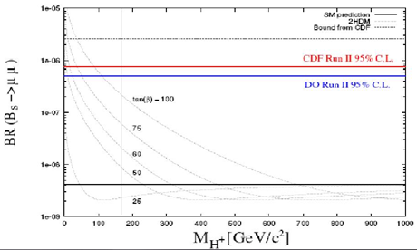
Tevatron and LHC progress in B_{s} → µ ⁺ µ⁻ search
~ 200 times for 10 years
CDF+D0
LHCB + CMS

Slide 23
Conclusions
LHCb with the integrated luminosity 370 pb⁻¹ provided the upper limits - Br (B_{s} → µ ⁺ µ ⁻ )< 1.4 x 10⁻⁸ at 95 % CL and Br(B_{d} → µ ⁺ µ ⁻ )< 3.2 x 10⁻⁹ at 95 % CL
LHCB-CMS combined result Br(B_{s} → µ ⁺ µ ⁻) < 1.1 x 10⁻⁸ at 95 % CL (CMS result Br(B_{s} → 2µ) < 1.8 x 10⁻⁸ (95 % CL)
Excess of the B_{s} → µ ⁺ µ ⁻ events reported by CDF (hep-ex/1107.2304) not confirmed
LHCb plans: to reach the sensitivity Br(B_{s} → 2µ) = 8 x 10⁻⁹ (95 % CL) with the existing integral luminosity L = 1.1 fb⁻¹
We hope to get a 3 σ evidence or better for the B_{s} → 2µ SM signal with the additional integrated luminosity L = 1.5 fb⁻¹ in the next 2012 year
PNPI participation: we are in primary authors in two last LHCb B_{s} → 2µ papers: hep-ex/1103.2465, arXiv:1112.1600v2
С наступающим Новым Годом!

Slide 24
Backup slides

Slide 25
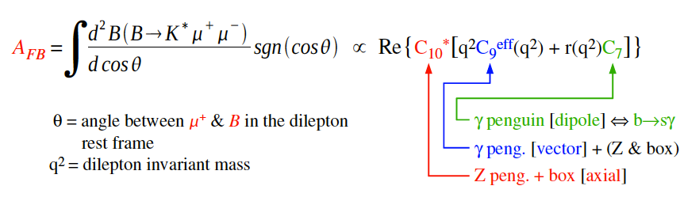
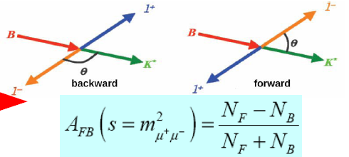
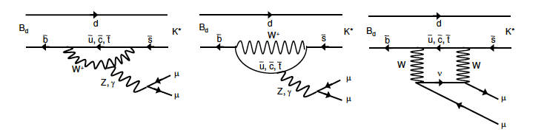
Search for NP in Bd→K*μ+μ-
The rare decay B0→ K0μ+μ− is a b →s, flavour changing neutral current decay, mediated by electroweak box and penguin diagrams in the SM
New particles (beyond the SM )can enter in competing loop-order diagrams resulting in large deviations from SM predictions
Forward-backward asymmetry A_{FB} of lepton system as a function of lepton invariant mass (q²) is sensitive to the helicity structure of New Physics

Slide 26
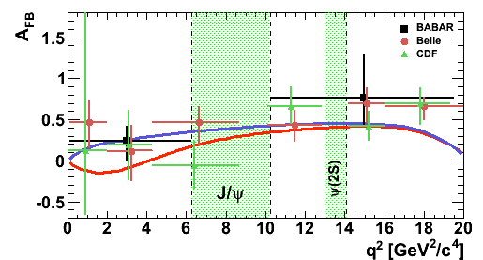
Results from CDF and B-factories show possible disagreement with SM at low q²
Search for NP in Bd→K*μ+μ-
Despite Standard model predictions experiments demonstrate positive magnitudes for the A_{FB} in the region 0< q² < 4 GeV²/c⁴

Slide 27
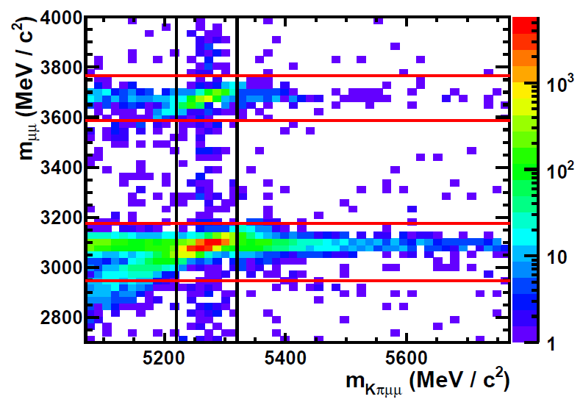
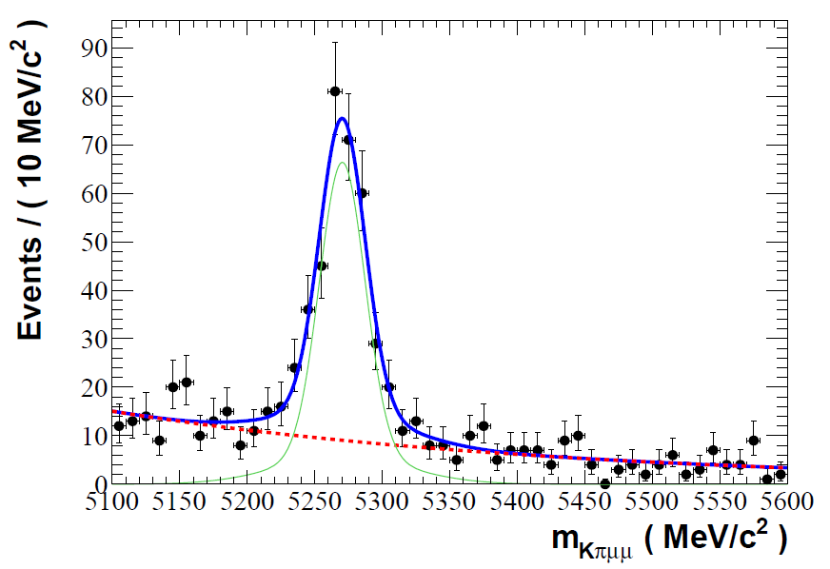
Events selection using Boosted Decision Tree from sample of 309 pb⁻¹
Search for NP in Bd→K*μ+μ-
Veto decays in J/Ψ and Ψ(2S) resonance regions

Slide 28
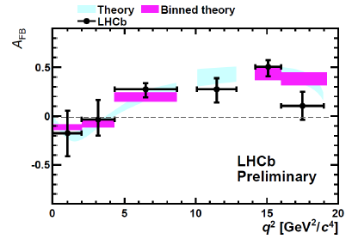
Search for NP in Bd→K*μ+μ-
C. Bobeth et al. [arXiv:1105.0376v2]
LHCb-CONF-2011-039
Data are consistent with the SM predictions at present sensitivity and indicate for the first time that the asymmetry is changing sign as predicted by the SM
LHCb result based on 309 pb-1 and 300 candidates

Slide 29
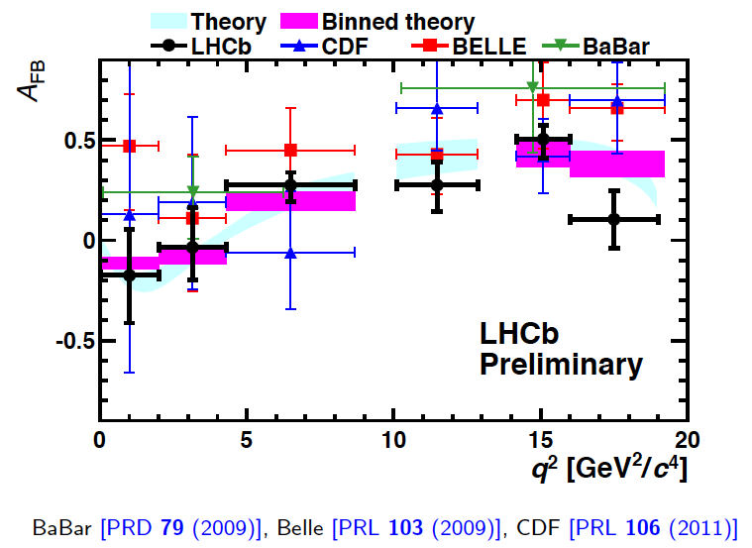
Search for NP in Bd→K*μ+μ-

Slide 30
CP violation in Charm
CP-violating asymmetries in charm provide a unique probe of physics beyond the Standard Model (SM)
• SM charm physics is (almost) CP conserving
• New Physics can enhance CP-violating observables
CP violation in charm not observed
CERN seminar yesterday, paper submitted to PRL
http://arxiv.org/abs/1112.0938

Slide 31
CP violation in Charm
D flavour tagged with
slow pion from D*
Physics
Detector
Production
1 kHz of trigger
bandwidth
allocated to charm
1.4 million
candidates

Slide 32
CP violation in Charm
First 3.5σ evidence for CP
violation in charm sector!
Analysis based on 60 %
of collected data. Update on
full dataset for Winter Conferences.
In addition parallel measurement
possible using semi-leptonic B
decays to tag D flavour
Result stable over time different magnet polarities and changing cuts

Slide 33
CP violation in Charm
Measure essentially direct CP
2010 LHCb study
of indirect CP violation
[LHCb-CONF-2011-046]
Result attracting theoretical interest
Before LHCb result consensus measurement at this level signified NP (Phys Rev D75 (2007) 036008] )
Conclusion now being revisited (e.g arXiv:1111.5000 )

